Slide 1






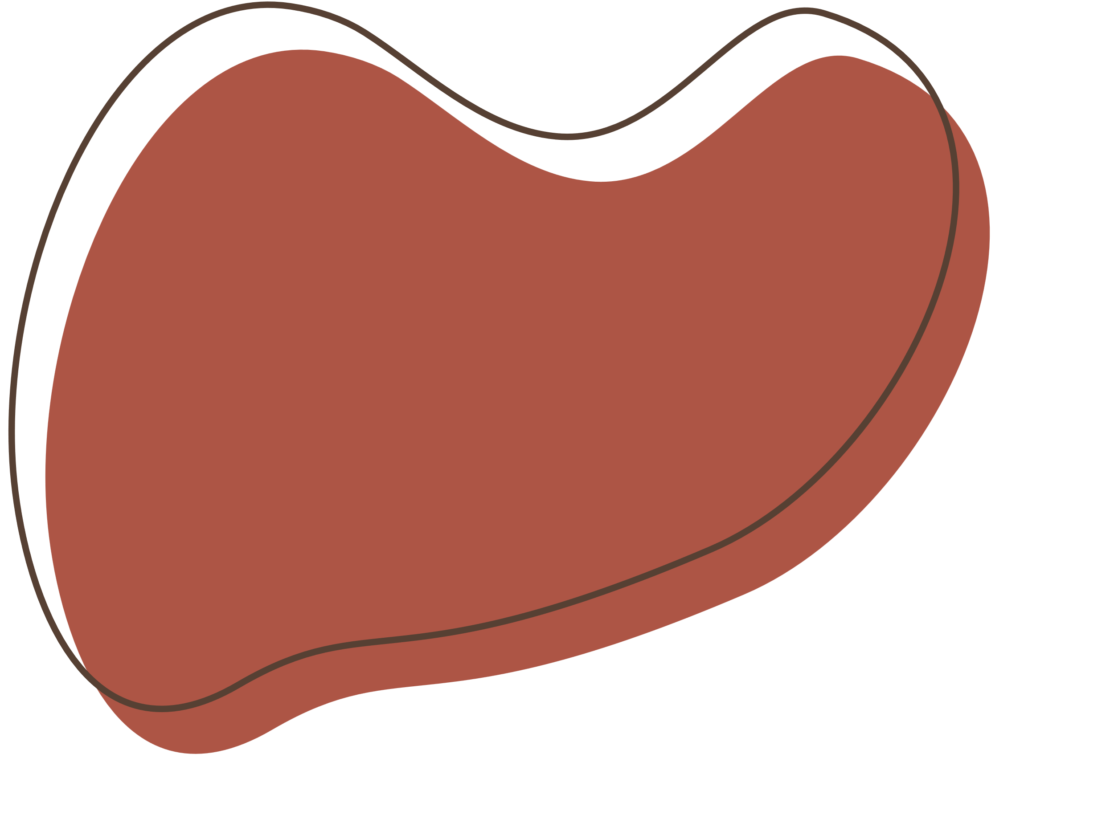
Road Safety Hackathon
Presented by Code Crusaders
TEAM MEMBERS:
Jagaadhep U k
KAVIN KUMAR VS
AAKASH SARAN V
Giridhar R
Mani Shankar S G

Slide 2
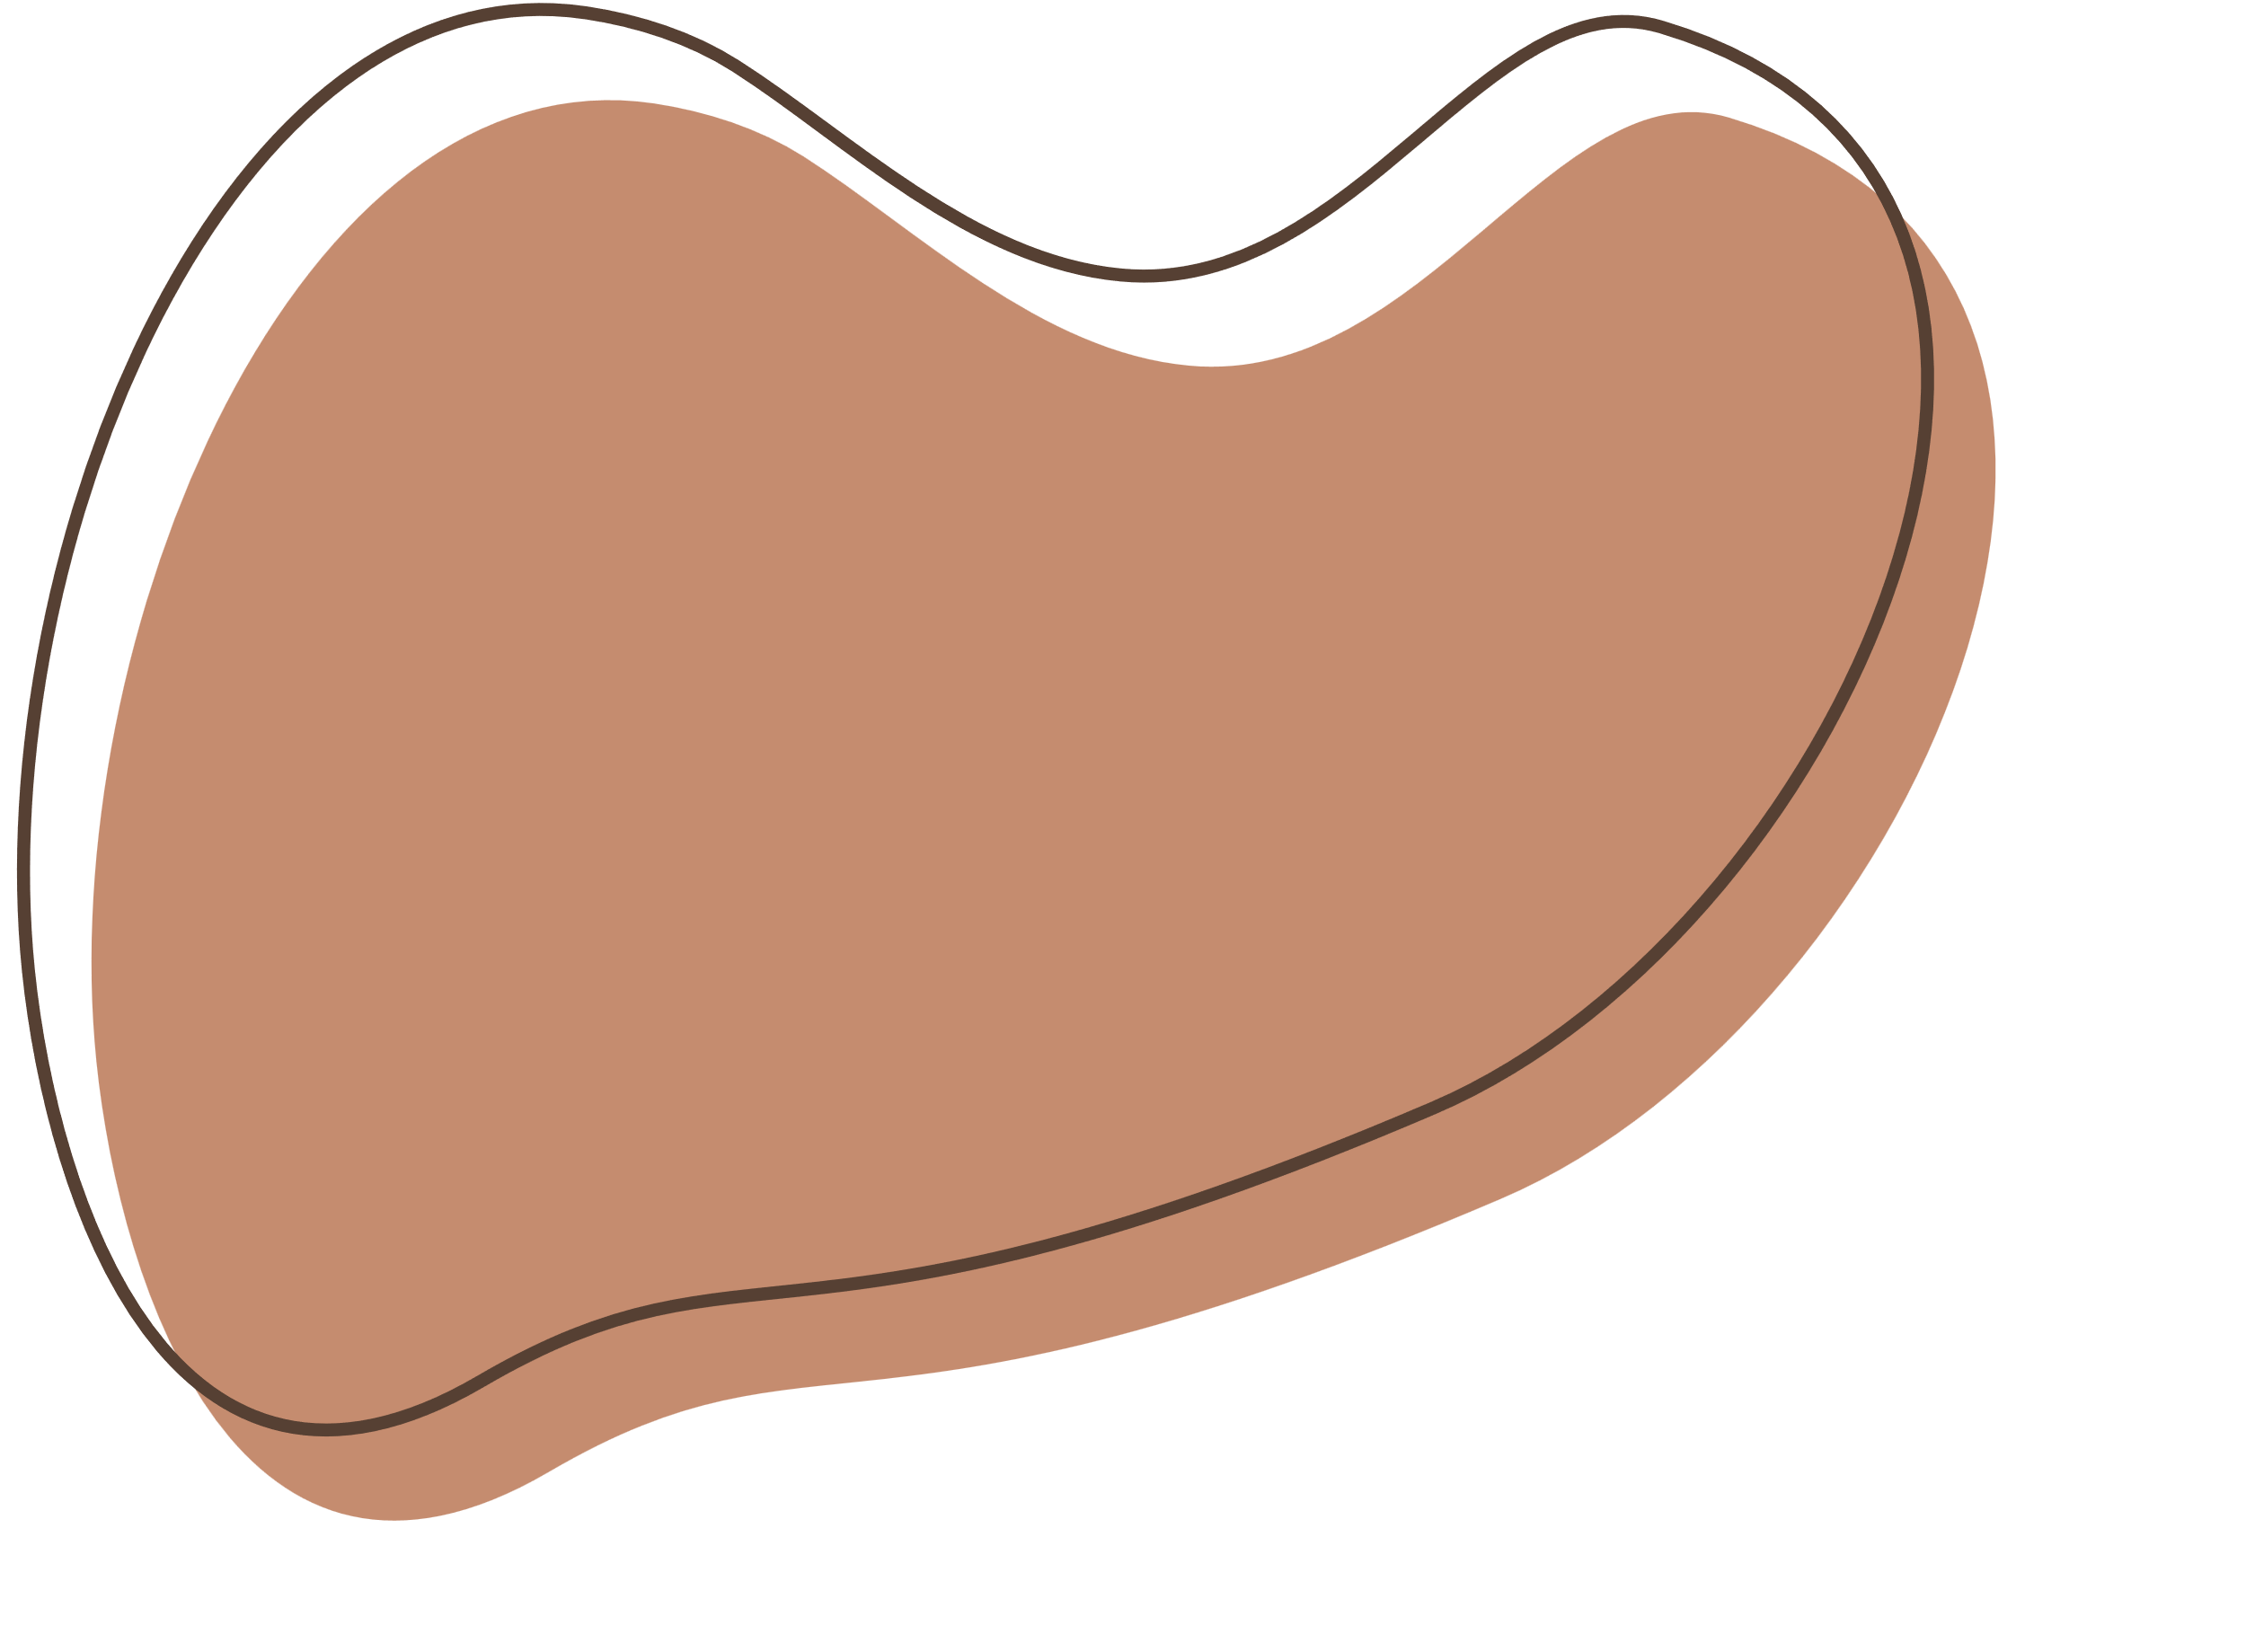







Topic
Accident Prediction and Prevention

Slide 3

Index
Concept of the Solution
Project Goals
Dataset
Technical Description
Implementation Plan
Future Improvements
References

Slide 4




Concept of the Solution
The Accident Prediction and Prevention System utilizes real-time video analysis, employing computer vision and machine learning. It identifies hazards like pedestrians, vehicles, and obstacles, predicting potential accidents to prevent them proactively.
In order to prevent accidents, the Accident Prediction and Prevention system is made to analyze video footage and identify possible mishaps. Based on past data, this system makes use of machine learning algorithms to identify trends and forecast accidents.

Slide 5

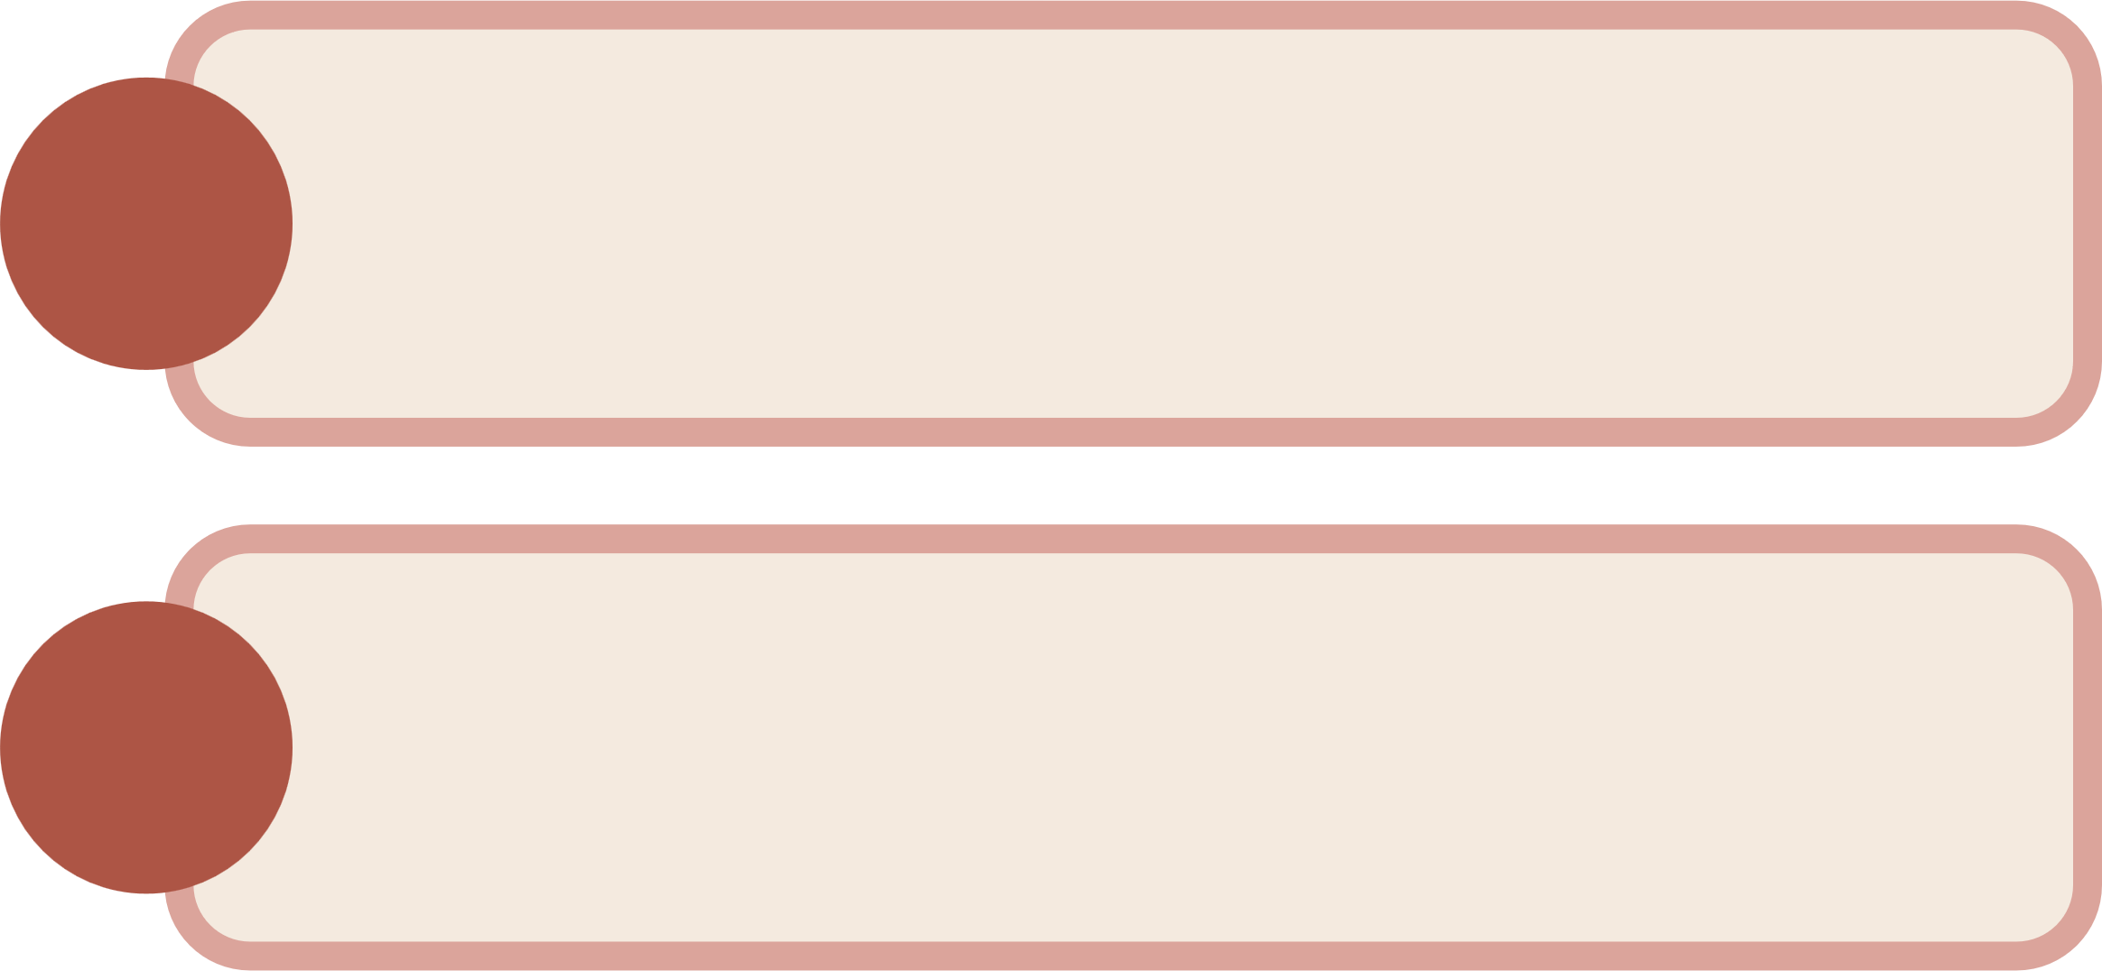
Project Goals
1.
Real-Time Accident and Location Detection: Develop a system that uses real-time video analysis to quickly identify incidents and their location as they occur.
Proactive Prevention of Accidents:
Utilize cutting-edge machine learning and computer vision techniques to assess object behavior and anticipate possible risks, enabling proactive accident prevention.
2.
Enhancing Road safety:
Contribute to improved road safety by deploying an automated system that enhances response times and proactively prevents accidents.
3.

Slide 6



Dataset
The image dataset consists of accident CCTV footage gathered from diverse locations, serving as the validation and testing set for the model.
Dataset is split into 3 folders - train, test and val. Each folder has Accident and Non Accident folders.
Consecutive frames of an accident are included in the dataset so the model can learn to differentiate between an accident and non accident.
Using Convolutional Neural Networks (CNNs), we construct a model designed to predict accident occurrences within video footage.

Slide 7
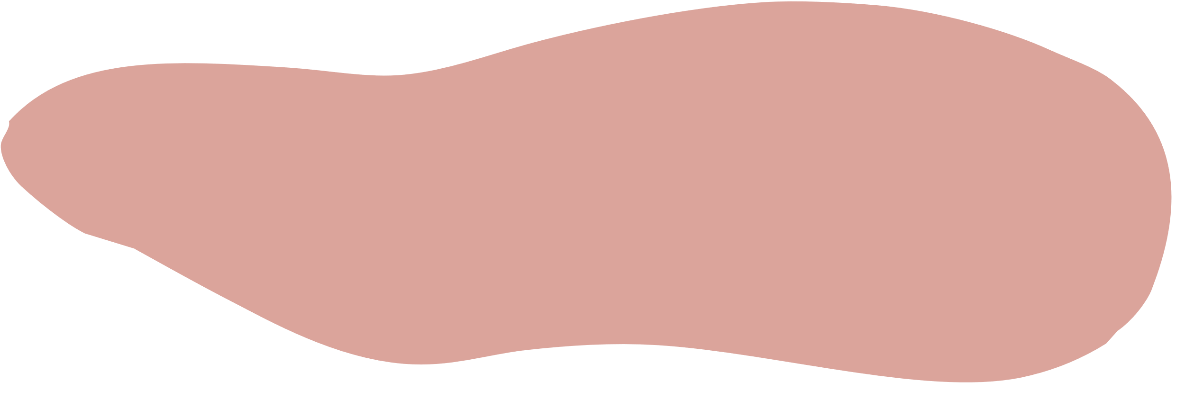


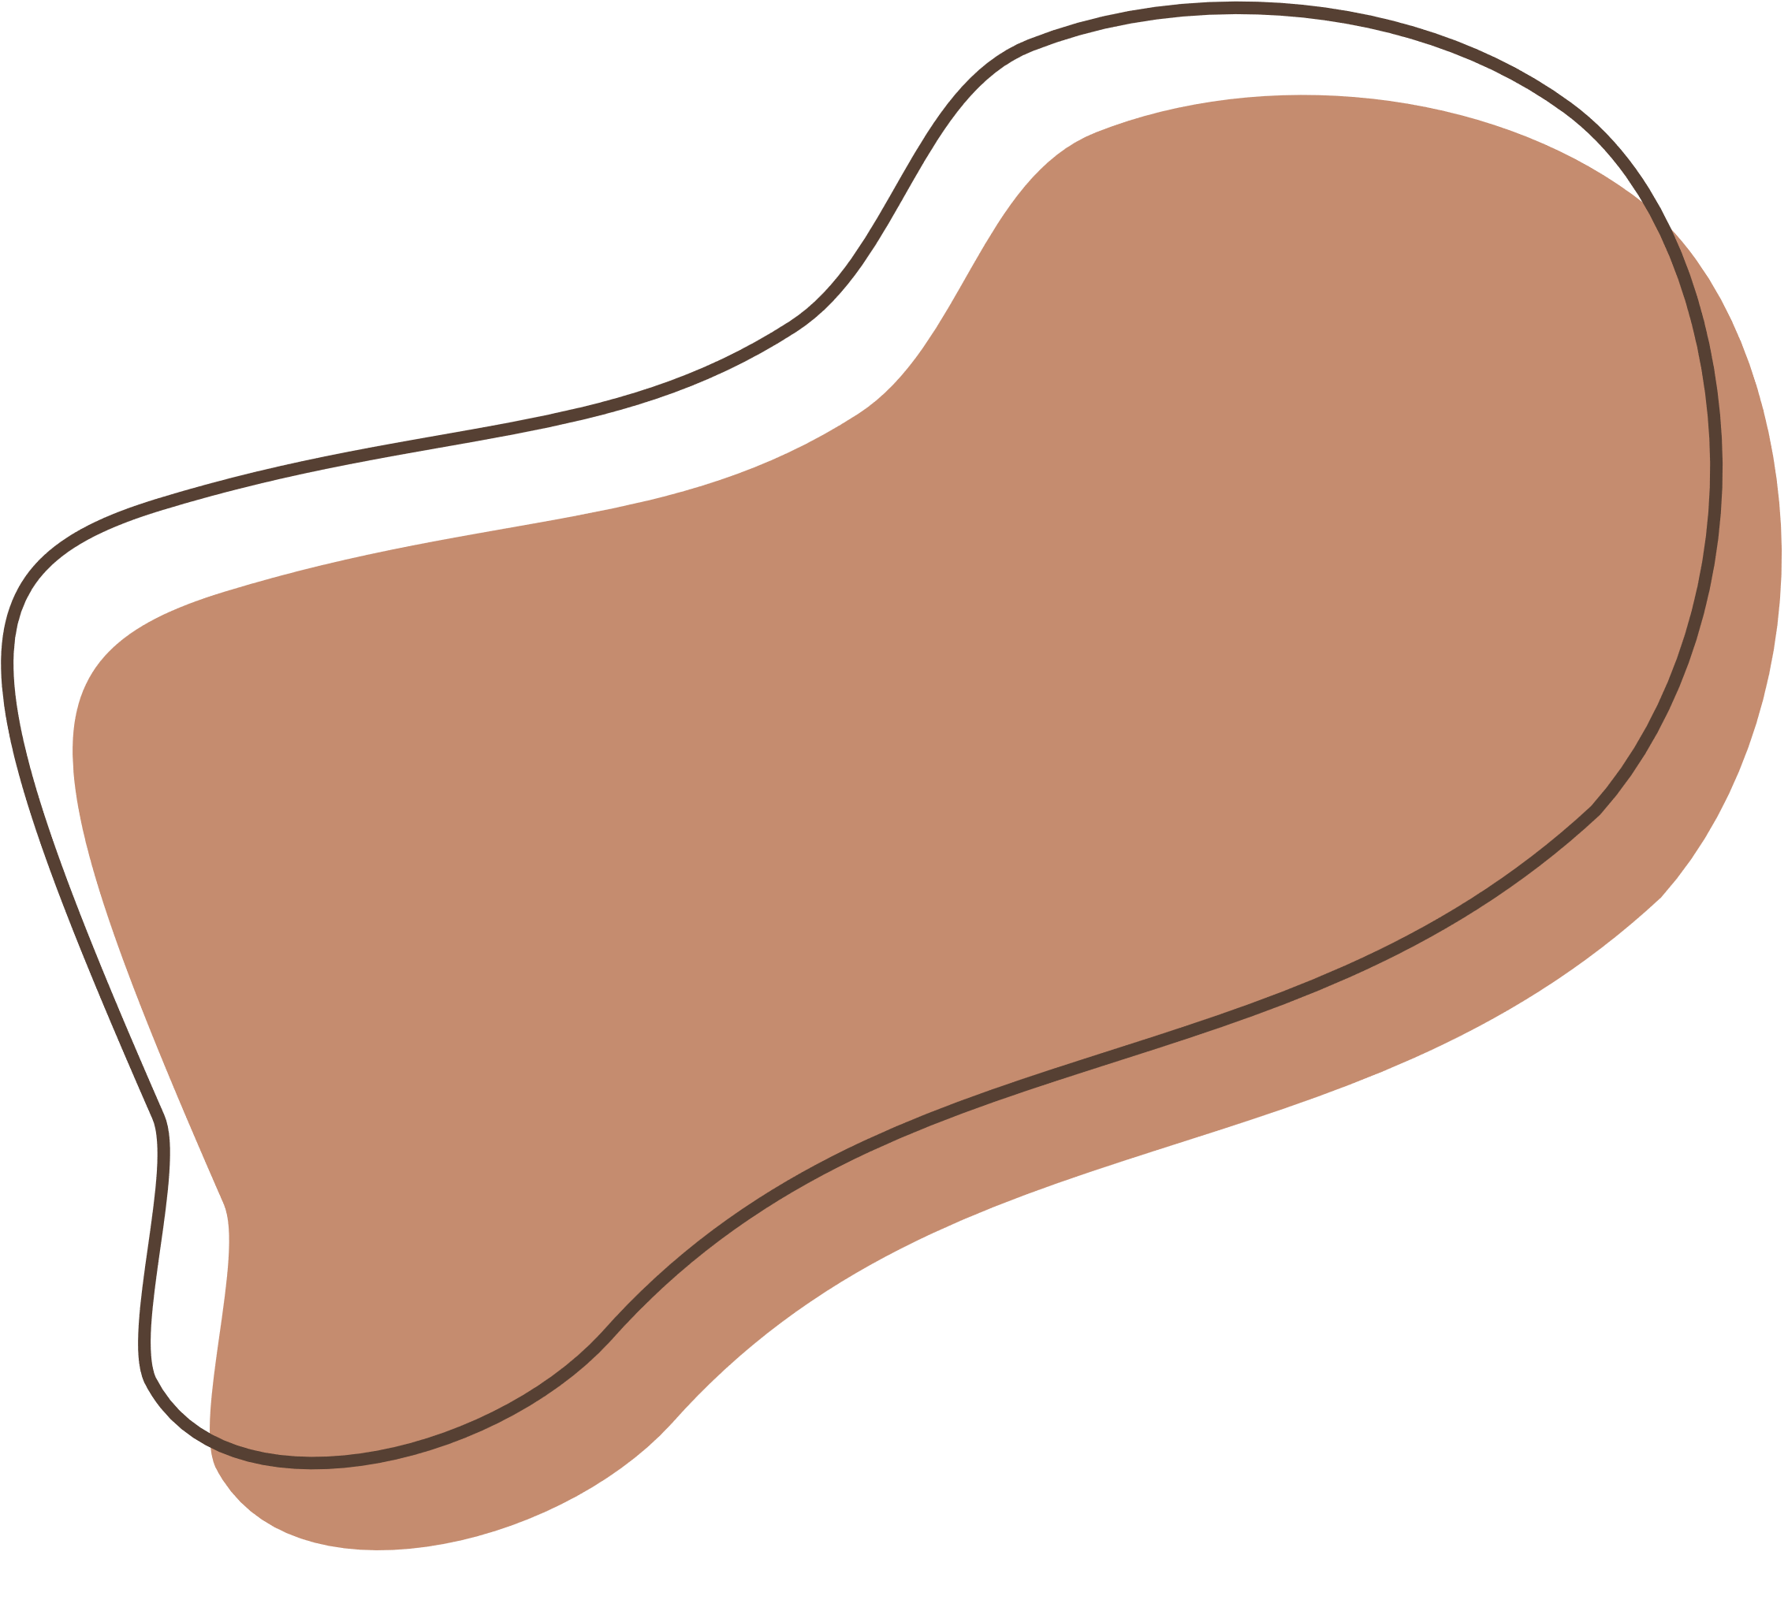
Technical Description
1. Video Analysis Process:
Object Detection: OpenCV is used to identify barriers, cars, and pedestrians.
Behaviour Analysis: Tracks movement patterns to anticipate accidents using TensorFlow/Keras.
Real-Time Processing: Effective Python modules enable quick decision-making.
2. Machine Learning Model: Predicts potential accidents by analyzing the behavior of identified objects.
3.Deployment and Integration:
Integration with Location/GPS system: The geopy library's Nominatim geocoder for reverse geocoding. Converts generated coordinates into human-readable addresses.
Integration with Emergency Systems: Facilitates easy communication for quick action with emergency services.

Slide 8




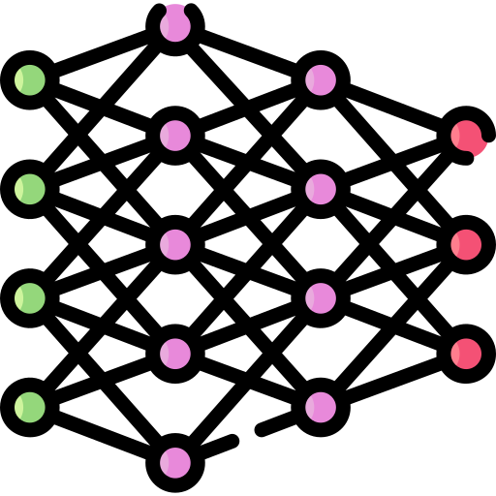






Implementation Plan
Frame processing:
Read the current frame from the CCTV footage stream and convert the frame to grayscale
Develop a model using Convolution Neural Network (CNN)
Brainstorm about the topic
Collect data
If an accident is predicted, annotate the frame with the prediction result and probability, and trigger an alert to nearby police stations and hospitals.
Location Detection:
reverse geocoding using the geopy library's ‘Nominatim’ geocoder to convert these coordinates into a readable location
Accident Prediction:
Use the trained model to predict and obtain the class and probability of an accident occurrence.

Slide 9

Future Improvements
Classification of Incidents: Expand the model to categorize different kinds of incidents or accidents, giving emergency services access to more precise data.
Integration with Traffic Management Systems: Collaborate with local traffic management systems to enhance overall traffic monitoring and incident response capabilities.

Slide 10

References
https://ieeexplore.ieee.org/document/7151519
https://jesit.springeropen.com/articles/10.1186/s43067-023-00124-y
https://ieeexplore.ieee.org/document/9582163
https://medium.com/geoai/using-machine-learning-to-predict-car-accident-risk-4d92c91a7d57
https://medium.com/analytics-vidhya/vehicle-accident-severity-prediction-based-on-environmental-stimuli-using-machine-learning-3b35b4599667

Slide 11



